Slide 1


Term 1 Week 6
Preparation for Source Analysis Test:
Social features of American society in the 1920s

Slide 2
Today’s Learning Intentions
Students will be able to:
Reflect on Assessment Task 1: In Class Essay
develop an understanding of the social features of American society in the 1920s.
Identify the elements in a source and the questions which may be asked in the Source Analysis Test in Week 8.

Slide 3
Assessment Task 2: Source Analysis Test – 10% Week 8
Please Note: Your source analysis test is currently being created and we will go over the questions for your test next week.
You will have THREE Sources ONLY based on Book 4.
You will have 50 minutes for the test. 5 minutes reading, 45 minutes writing time.
You will have five questions adding up to 20 marks.
The questions may ask you to address:
Historical context
Origin
Message
Purpose
Usefulness
Perspective
Reliability
Final details will be released in Week 8.

Slide 4
Instructional terms you may be asked:
Explain
Identify
Outline
Account for
Compare and contrast
Discuss
Analyse
Assess
Evaluate

Slide 5
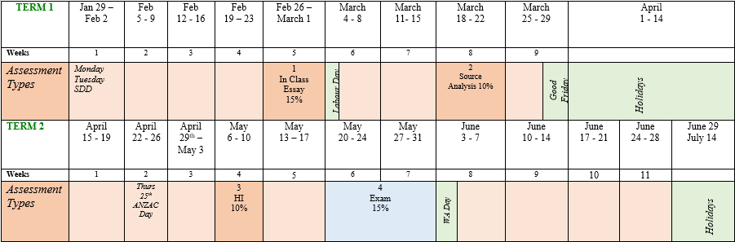
Semester 1: We are here:

Slide 6
Review of Webex Lesson if you miss the lesson: To be sent within seven days of missing the lesson.
What I learnt today:
What went well:
Even better if:
Notes:
Send students off to their white boards to answer ONE of these questions only.

Slide 7
Reflection on Assessment Task 1: In Class Essay on the social features of American society from 1901 to 1918.
What went well?
Even better if…………..

Slide 8

Question time:
Do you have a question you would like to ask me?
Yes ???

Slide 9
Glossary
Places
People
Other
Events
Terms
Prohibition
Flappers

Slide 10
Forces from the syllabus:
Economic
Political
International
Relations
USA 1907 - 1941
Social and Cultural
Leadership
Ideas

Slide 11
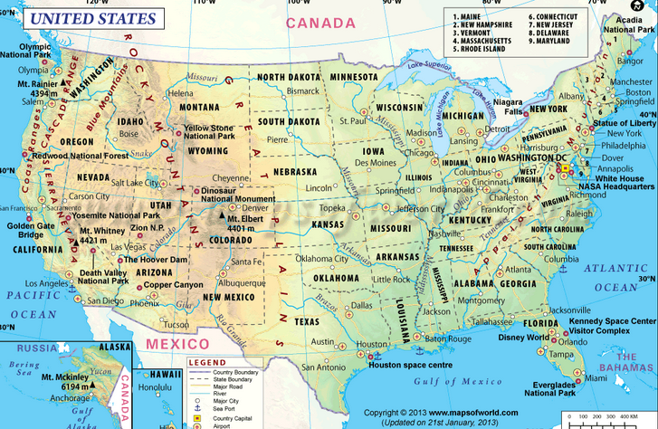
The USA
Notes:
Ask student if they know where the first 13 colonies were located. Asked students if they know the states in the union and confederacy.
Introduce the term Manifest Destiny. Add to Glossary.

Slide 12
LACK PANTS
Go to Nearpod:
L
A
C
K
P
A
N
T
S

Slide 13
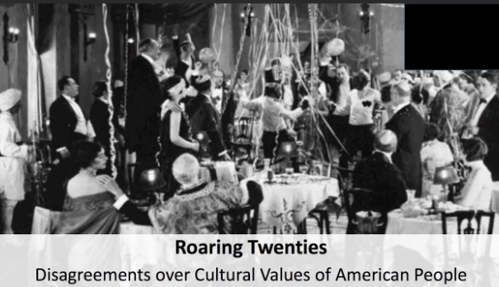

Slide 14
Many conservative Americans, especially White, Anglo, Saxon Protestants or WASPs:
Felt threatened by the changes occurring in society.
Resented the small advances made by the African Americans in World War 1.
Felt moral values were being attacked by urban intellectuals.
Feared job competitions from immigrants.
Were convinced foreigners were going to overthrow the American way of life.

Slide 15
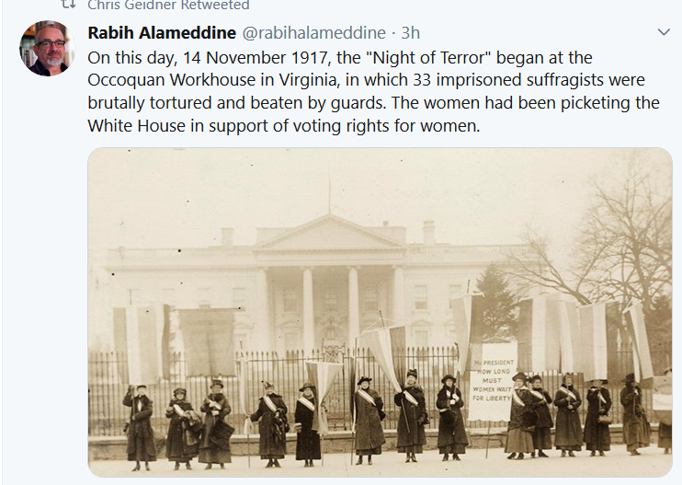
Suffragettes
Notice the women’s fashion of 1917.

Slide 16
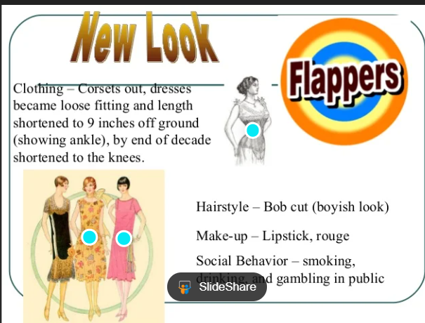
drinking and

Slide 17
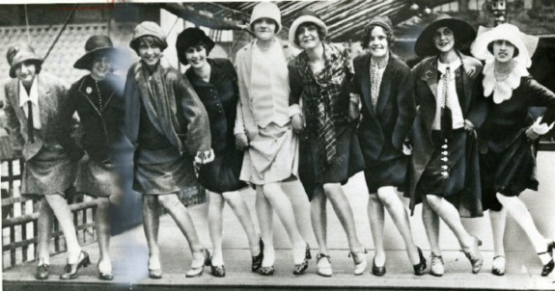
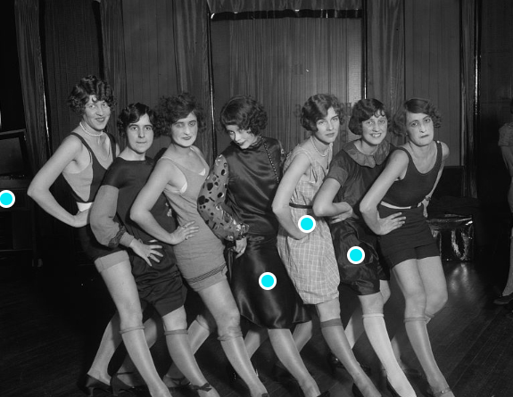
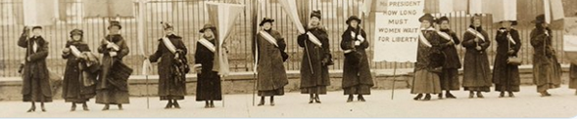
Flappers

Slide 18
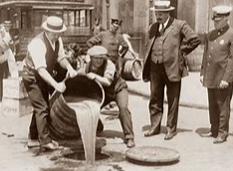
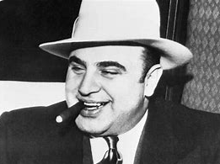
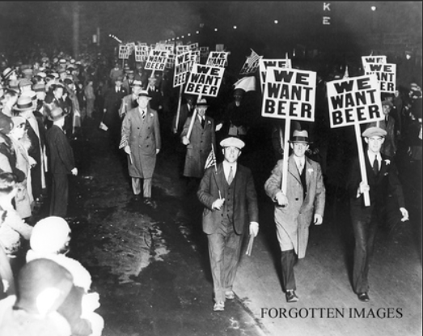
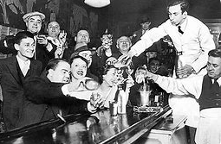
Who was the greatest gangster of the 20s?
Speak Easies
Prohibition: 18th Amendment to the Constitution

Slide 19
Source Analysis Book in Skills Tile in Moodle
Please note:
The 2024 Atar Modern History Course has changed considerably in the Source Analysis section.
The Source Analysis Book in Moodle is extremely useful in explaining how to analyse sources BUT ignore all the marking keys and questions as these have changed.

Slide 20
Source Analysis
What is a source?
It is a window to the past
Primary
Secondary
Glen Close: Golden Globe Awards 2019:
“Film gives us the opportunity to use two eyes to see the world through two different eyes.”

Slide 21
Historical Interpretations
Historical interpretations change as a result of:
Time
Place
For example: Attitude towards Germans.
During and after World War 1 there was a strong, negative view of Germans – one of the reasons for the introduction of prohibition.
During and after World War 2 there was a strong, negative view of Germans
Today, Germans are a strong ally in the war in Ukraine.

Slide 22
FIVE (5) key steps to success in Source Analysis
There are FIVE (5) simple steps to success in Source Analysis Tests:
Know your content knowledge
Understand the intent of each question – that is, what is being asked in each question
Practise analysing sources and acquire a sound general knowledge
Good time management
Planning of all responses

Slide 23
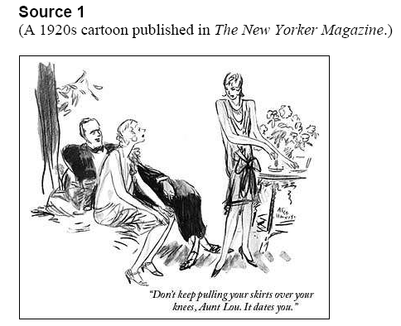
Source Analysis Preparation
Deconstructing a source.
E
HC
A & P
T
Mo
Ps
Pp
M
U
C

Slide 24
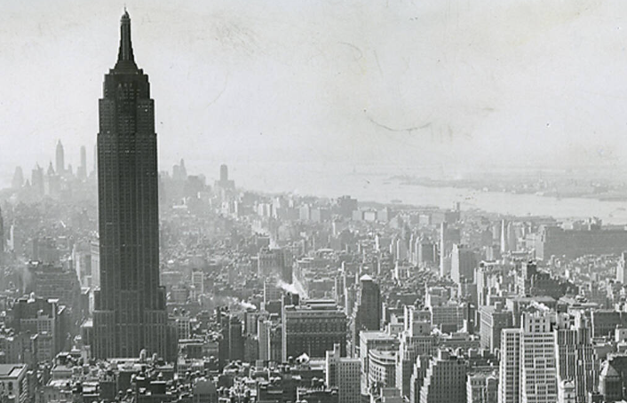
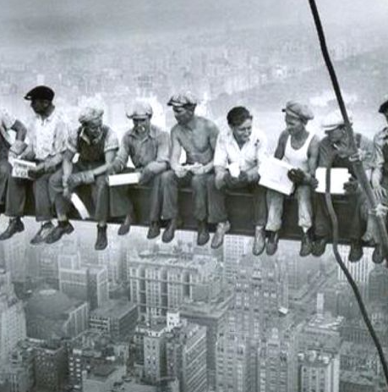
New York Skyline 1920s
Can you name this building?
Constructing the Rockefeller Building

Slide 25
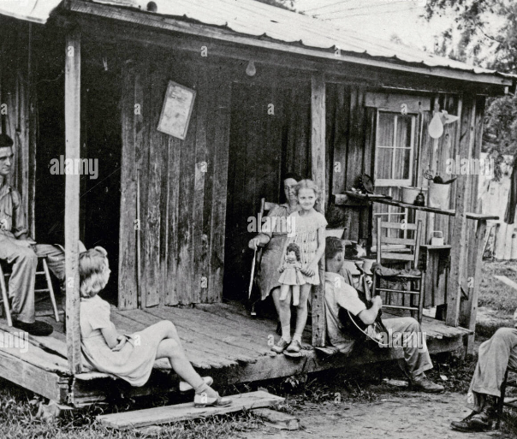
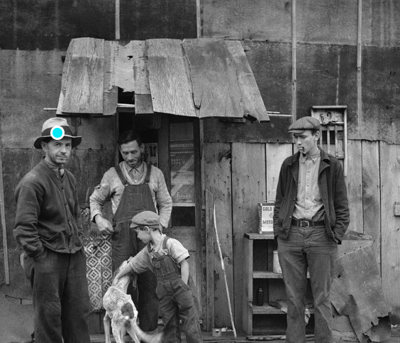
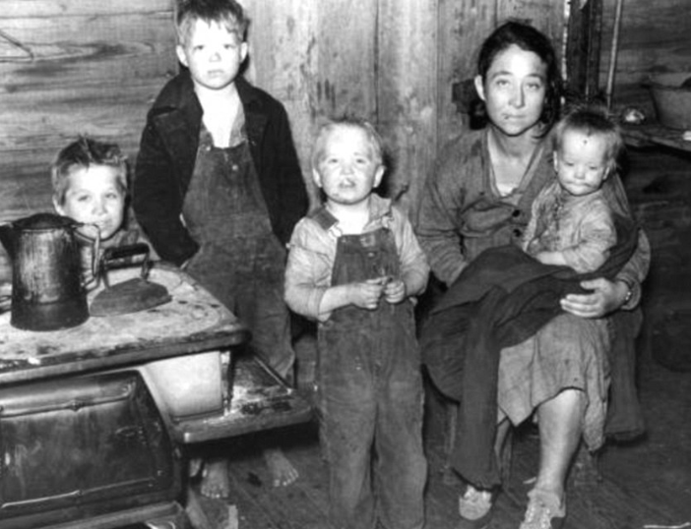
Rural areas of poverty in the 1920s

Slide 26
Forces from the syllabus:
Economic
Political
International
Relations
USA 1907 - 1941
Social and Cultural
Leadership
Ideas

Slide 27
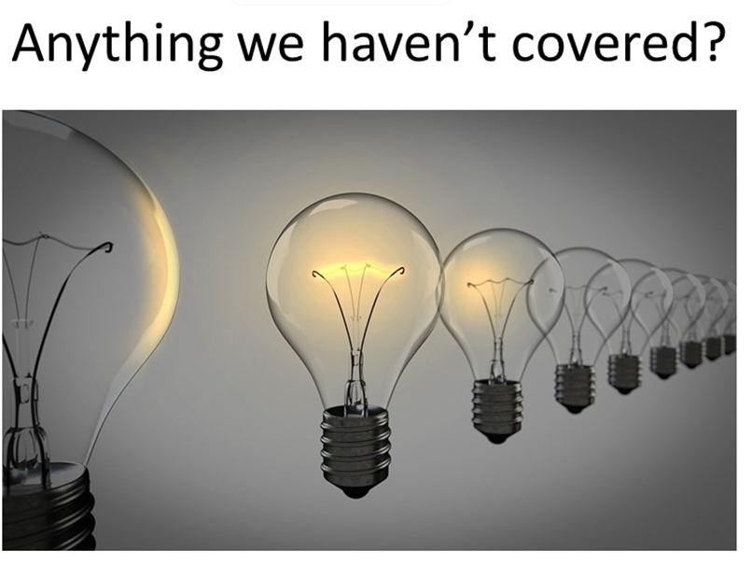

Slide 28
Student Voice
What I learnt today:
What went well:
Even better if:
Notes:
Send students off to their white boards to answer ONE of these questions only.

Slide 29
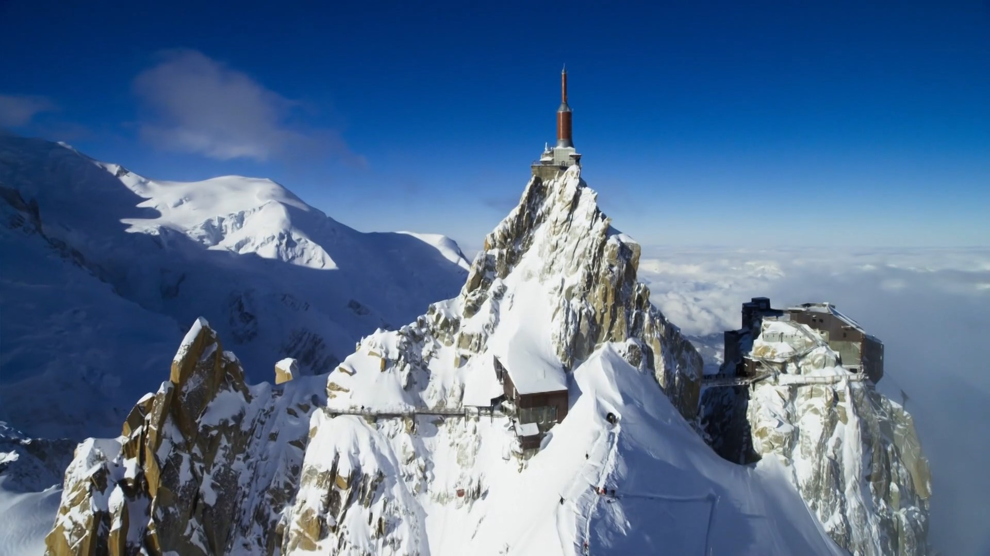
Where are you right now?

Slide 30


